Slide 1

APEC 100 Sustainable Development
Importance of Evidence Based Policy

Slide 2



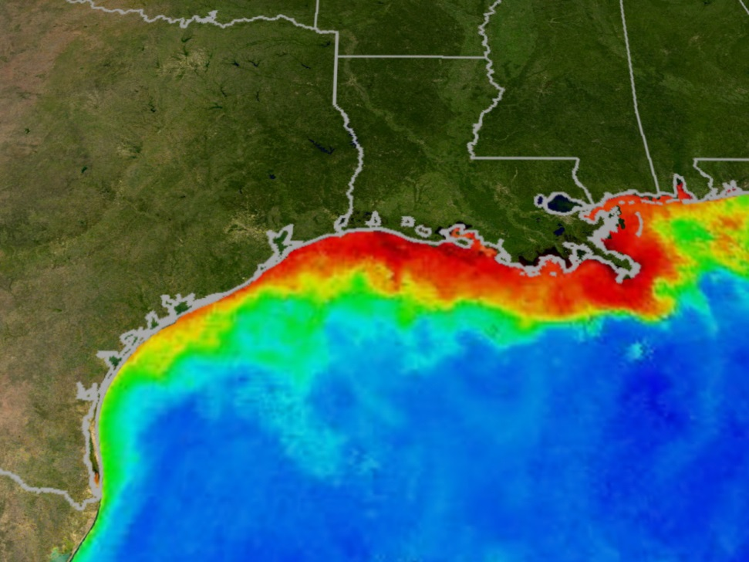
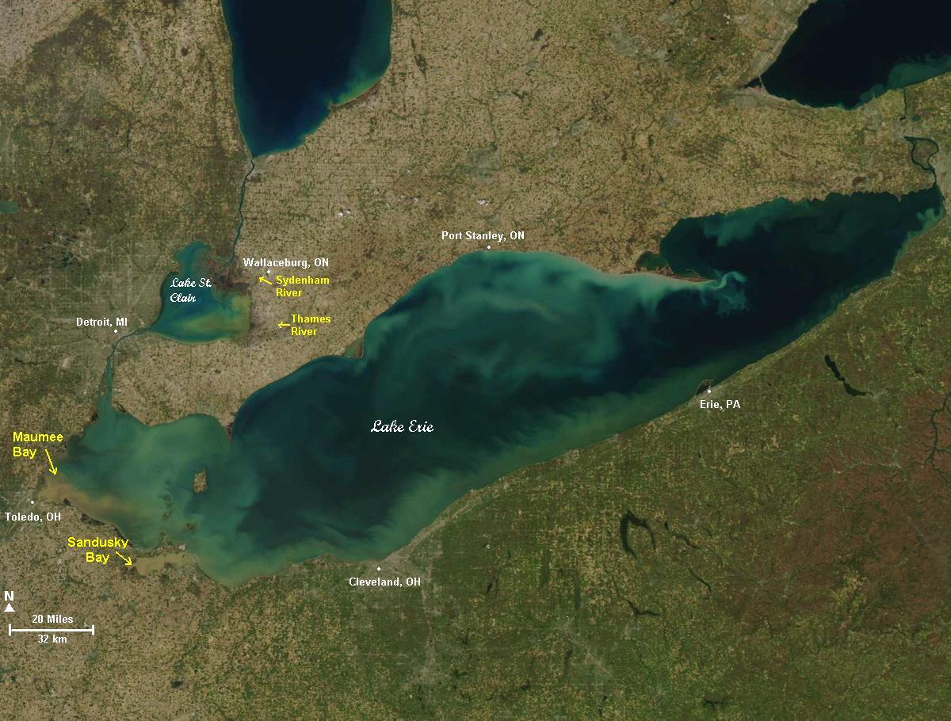
Challenges with Agriculture and Water Quality
Dead Zones
Algal Blooms
Did US agri-environmental policy fail?
Or did agri-environmental programs prevent a much worse situation?

Slide 3
Evidence-Based Policy
President Obama’s Evidence and Innovation Agenda
“… strengthening agencies’ abilities to continually improve program performance by applying existing evidence about what works, generating new knowledge, and using experimentation and innovation to test new approaches to program delivery. … This is especially important given current fiscal challenges, as our nation recovers from a deep recession and agencies face tough choices about how to meet increased demand for services in a constrained resource environment.”
Memorandum to the heads of departments and agencies, 2013

Slide 4
Long History of Applying Evidence-Based Principles in Agriculture and the Environment
In agriculture, we apply scientific principles to study the specifics of crop management techniques.
Collect data on control plots, control for confounding factors, etc.
Environmental efforts have likewise relied heavily on scientific principals.
Scientific investigations related to agriculture and the environment should not stop when human behavior enter the picture.
Recent reports indicate that USDA is behind other agencies in applying evidence-based policies and behavioral science to improve program performance.
CBEAR is designed to help.

Slide 5
Test, Learn, & Adapt
Haynes et al., argue strongly for the use of randomized control trials (RCTs) for the analysis and evaluation of public programs and policies.
Testing new interventions against status quo or against alternative interventions (including variations in existing interventions).
RCTs help eliminate rival explanations.
RCTs are very similar to crop trials in agriculture.
RCTs have been used since the 1950s in the private sector (drug trials) and in areas of education and criminal justice.
RCTs help eliminate rival explanations and help identify causal relationships.
Notes:
Authors work for a British Cabinet office called Behavioural Insights.

Slide 6
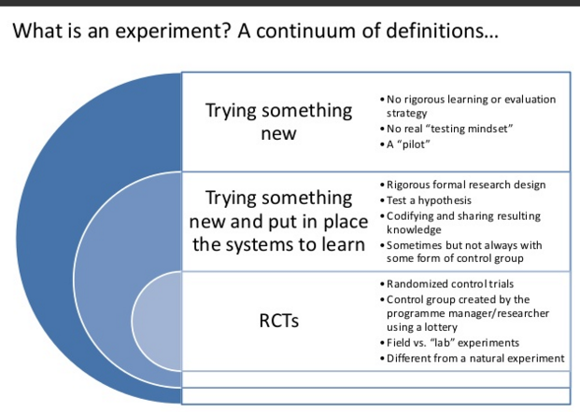
The difference between an experiment and a “pilot”
Source: Albert Bravo-Biosca, Using Experiments in Innovation Policy

Slide 7
Evidence-Based Program Evaluation: An Example
Why not just introduce a new program and observe what happens?
For example, consider a voluntary incentive program to reduce pesticide applications.
Time-Varying External Factors:
Other changes in the environment can cause changes in outcomes that are not attributable to the intervention.
External factors could include local economic conditions, changing requirements from state governments, variations in weather, and/or changes in the frequency of pests.
Selection Bias:
The participants in the new program (the ‘treated’) might systematically differ from those who choose not to participate in ways that affect their outcomes.

Slide 8
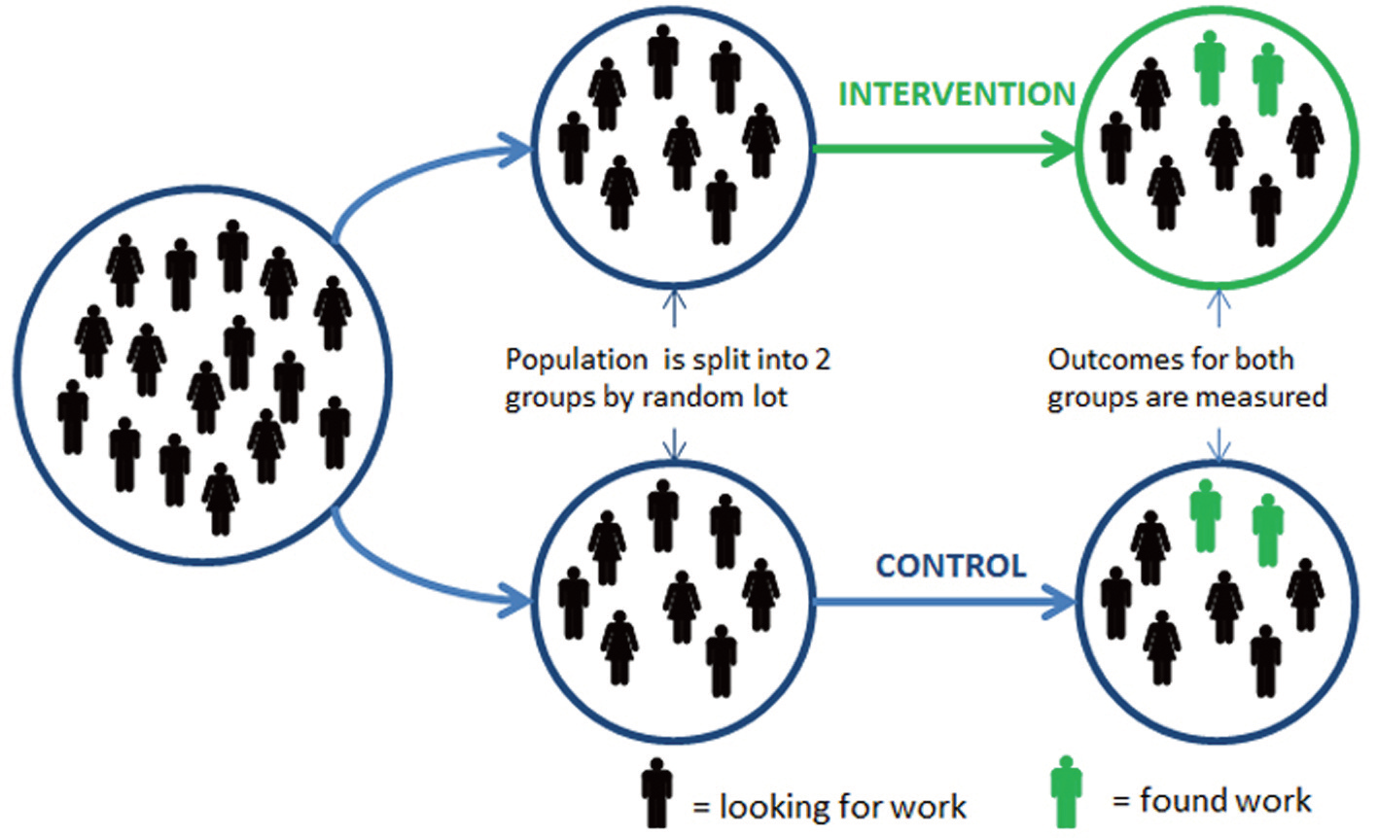
Key Advantage of RCTs
RCTs are better able to avoid these problems.
First organize into a large group of units (farms, landowners conservation districts, etc.)
Randomly dividing units into treated and control groups.
External factors are the same. No selection bias. (Subjects can be matched in terms of relevant characteristics.)

Slide 9
Importance of Counterfactuals
Before the Program
(Pre-Treatment)
After the Program
(Post-Treatment)
C: Post-Treatment Outcome when Treated
Treated Units
(participant farms)
A: Pre-Treatment Outcome
D: Post-Treatment Outcome when Not Treated
E: Post-Treatment Outcome when Treated
Untreated Units (nonparticipant
farms)
B: Pre-Treatment Outcome
F: Post-Treatment Outcome when Not Treated
Use what you can observe (A or F) to stand in for what you cannot observe (D)
Shaded Boxes are Observable
Unshaded Boxes are Unobservable

Slide 10
Importance of Counterfactuals
Consider the Scared Straight program meant to deter juvenile delinquents from further crime.
Juvenile delinquents interactions with serious criminals in prison who would describe how horrible prison life is.
Early studies without control groups suggested participants were less likely to commit crimes after the experience. These studies compared behavior of participants before and after the intervention.
Several well-controlled RCT studies were conducted. Evidence was fairly clear that “Scared Straight” led to increases in criminal behavior, compared to no intervention.
Programs were expensive to run and, even worse, they led to further costs by increasing crime.

